Slide 1

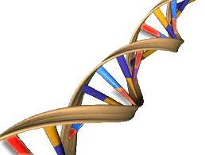

GNomEx
Challenges and Solutions
for Managing the Complexities
of a Genomic Core Facility

Slide 2
Tony Di Sera
Passionate about Software, fascinated by Molecular Biology.
Over 20 years in the software field
Intel
Human Genome Project
Hunstman Cancer Institute at the University of Utah
Original author of GNomEx, Project Lead
LIMs Software Startup
Notes:
First start, witness the manifestation of moores law
Transitioned to BioTechnology
Privelged a similar explosion in ….
In Biotechn. When Human Genome project was just underway….
Talk about when first Humane Genome seq was published in Nature….
Cimarron – Convergence of interesting, opinonated software developers. Team because pretty large pretty quickly. Software took on LIMs in a packaged systems approached.

Slide 3
University of Utah and
The Hunstman Cancer Institute
3 Genomics Cores
Bioinformatics Core
HCI Research Informatics + Sys Admin

Slide 4
Our Job is…
To deliver clean, beautiful data to the Researcher as quickly as possible…..

Slide 5

GNomEx at a Glance
LIMs
Order Tracking
Workflow
Email Notification
Results Delivery
Data Repository
Analysis Project Center
Configurable Annotations
Private to Public Visibility
Submit
Experiment
Workflow
Results
Delivery
Automated
Billing
Analysis
Visualization

Slide 6
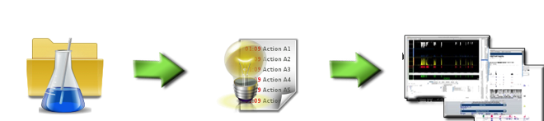
GNomEx Overview
Data Flow
Experiments
Analysis
Visualization

Slide 7
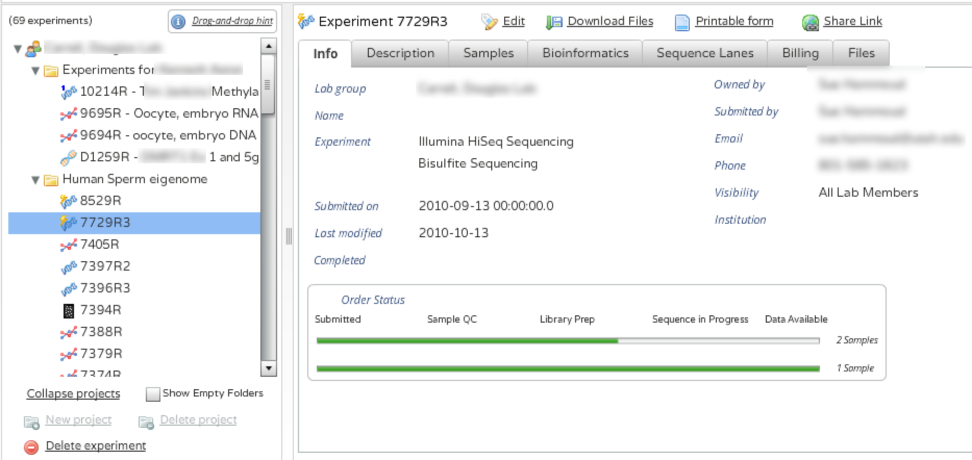
GNomEx Experiments

Slide 8
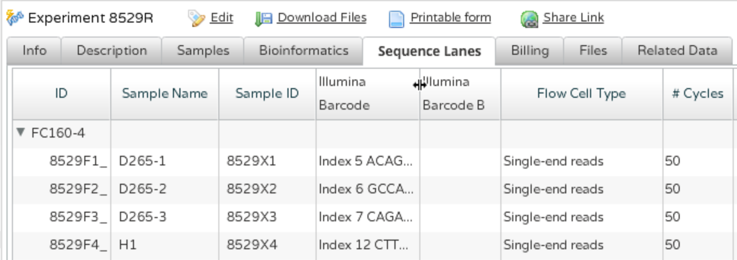
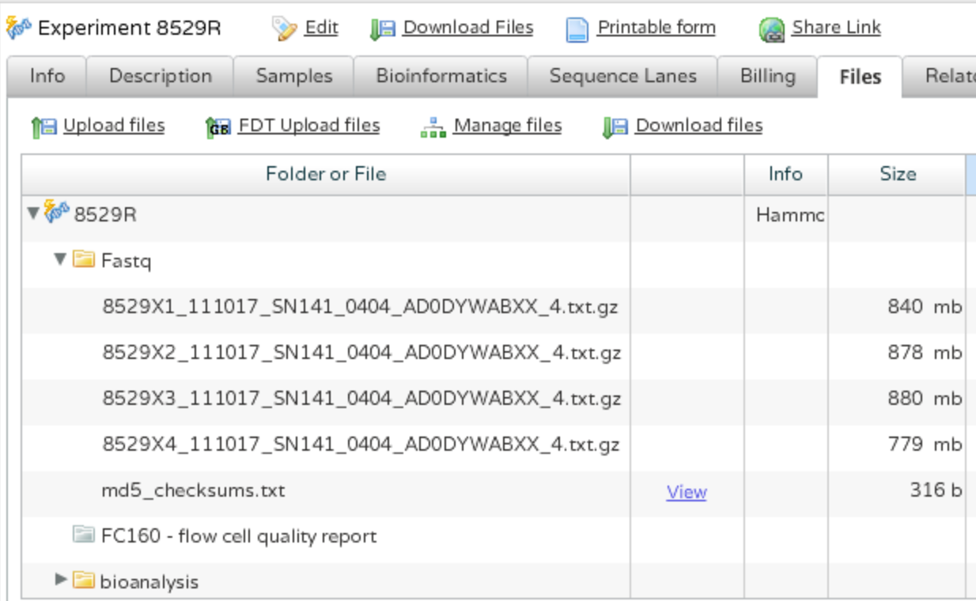
Experiments cont…

Slide 9
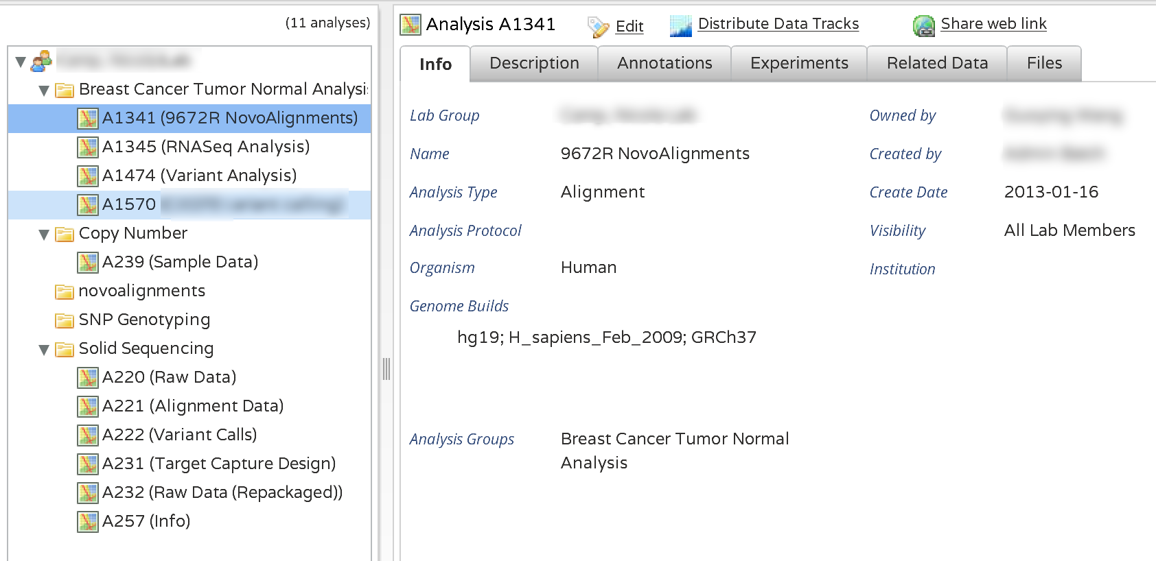
GNomEx Analysis

Slide 10
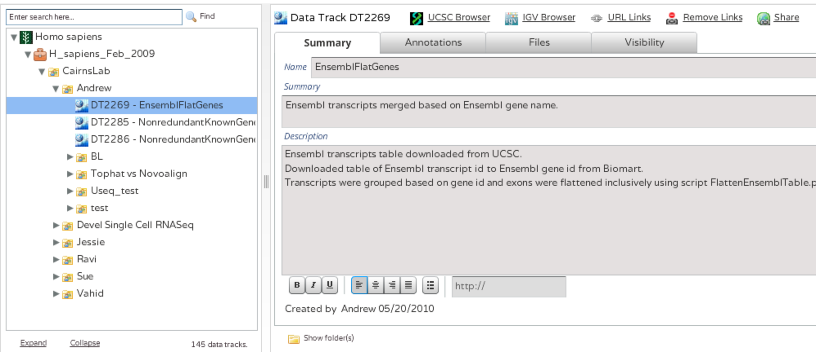
Visualizing your Data

Slide 11
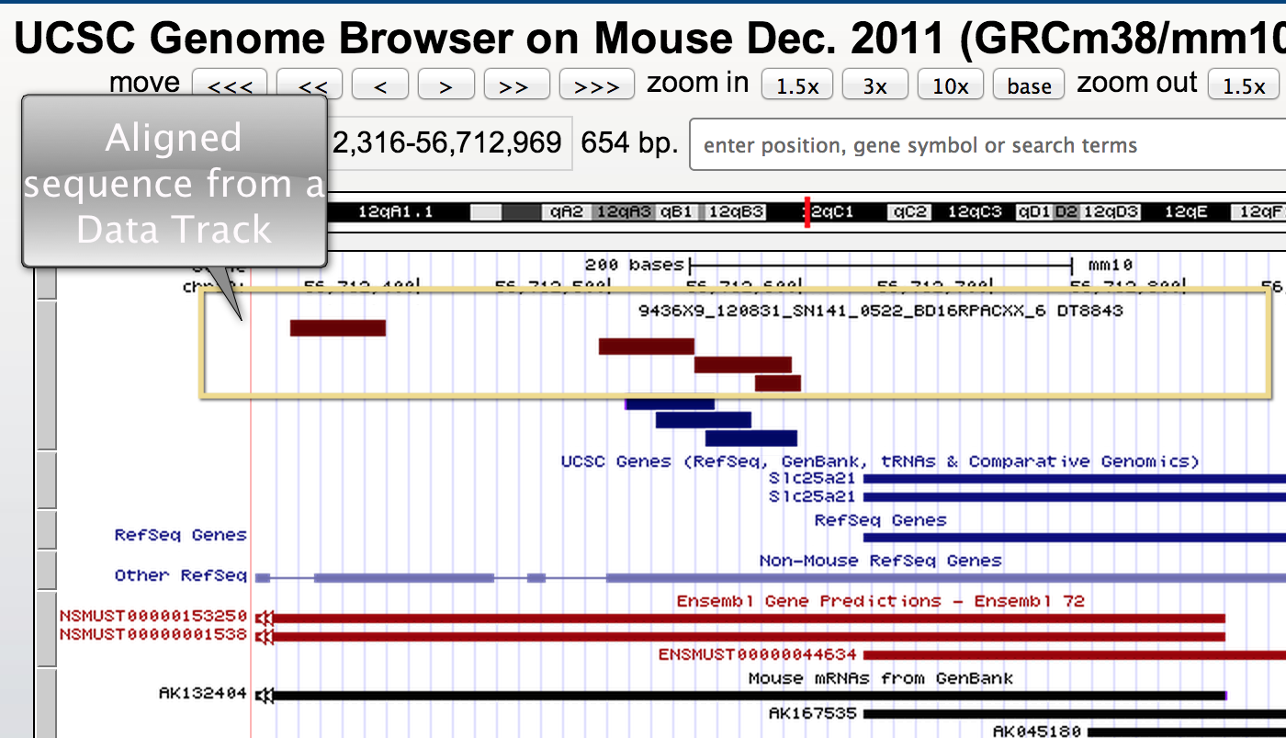
Visualizing your Data

Slide 12
Three Challenges
Data
Demand
People

Slide 13
Challenge #1
BIG Data
Complicated Data
Sensitive Data

Slide 14
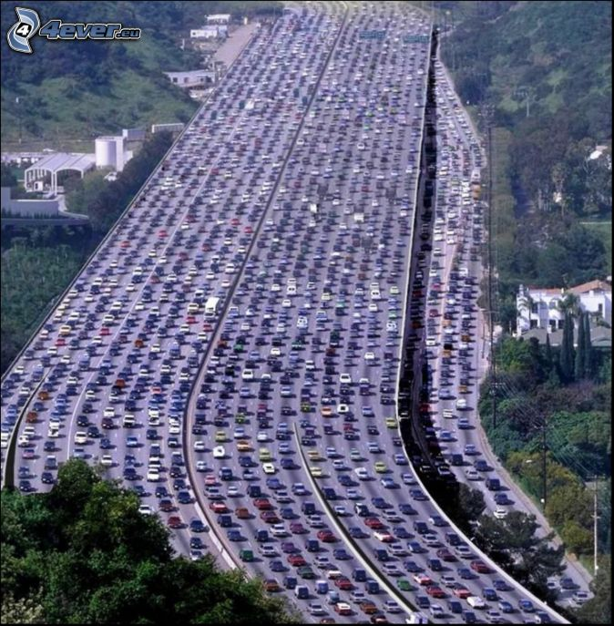
Big Data
If you don’t have slack in the system, your throughput drops to a crawl.

Slide 15
Big Data
Build as you go
Buy BIG upfront
The Cloud
Notes:
Frankenstein graphic
List different file systems
Vulnerabilities with single points of failure
Uniform permissions across different file systems and operating systems.
Isolon solution
Advise – Hire a tallented system admin

Slide 16
Fast Disk
For Computationally Intense processes
Slow Disk
For Large Storage
2 X Faster than Slow Disk
Fast RPM SCSI
Files have short life
Infrequent Disk Hits
Files have long life span
Mountable to GNomEx and Analysis Pipeline
Notes:
Fast Disk - < 100 TB
Slow Disk - RAID5
Tape Backups

Slide 17
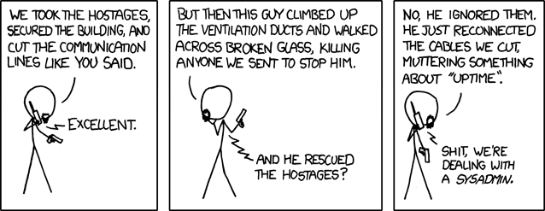
If you store your Data In-house….
Hire a talented, fearless, focused Sys Admin
xkdc
Notes:
That worries about backups
That will stay up all night to ensure there isn’t downtime
Who guards the system as if it were his own Xbox
Who can geek out over network cards, file systems, disk controllers and clusters

Slide 18





Transferring BIG Data - FDT by CalTech
Connection
& Control
Management
Pool of directly mapped buffers
Pool of directly mapped buffers
Data Transfer Socket
Independent
Threads per
Device
Restore Multiple
Files Concurrently
Notes:
Get speeds from David
Firewall chokes

Slide 19
Big Data,
Big Processing
Notes:
How did we fail – Ask David - How did we first analyze data? When did it become obvious that we need the clusters

Slide 20
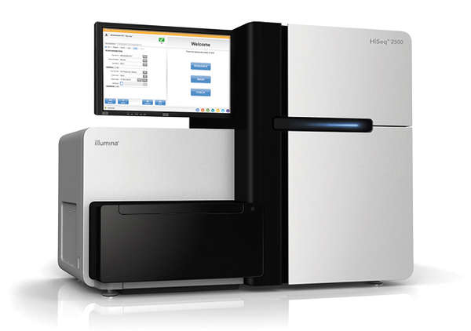
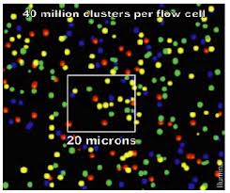
Illumina Data Pipeline
GNomEx
Barcode Tags
Experiment Info
Run Info
Images
Image Processing
FastQ
File Splitting
FastQ
Experiment Folders

Slide 21
Sequencing Analysis
Align
Recalibrate
SNP Indel
Annotate
Annovar, VAAST, Varscan
GATK
Novalign
Chip SEQ
RNA Seq
Identify likely ChIP Peaks
Find differentially expressed genes from transcripts
Align around known Indels

Slide 22
Automated Analysis Pipeline
# run novoalign with default parameters
#e david.nix@hci.utah.edu
#a A1325
@align -g hg19 -i *.txt.gz
#map, recalibrate and call SNP/INDEL w/ GATK
@snpindel -g hg19 -i A*.txt.gz
#map, recalibrate, call SNP/INDEL, annotate
@annot -g hg19 -i control_A*.gz case_B*.gz
-vaast -annovar
Simplifies running analyses on cluster
Fully versioned
Customizable

Slide 23
Complicated Data
The Data Model
Sample Annotations
Experimental parameters, multiplexing, and protocols
Data Genealogy
Tie many experiments and analyses together
Configurable Annotations
Workflow
Links from Experiment to Analysis
Topics
Experiment
Protocols
Lanes
Sample
The File System
Folder 1
File 1
File 2
Folder 2
Files A
File B
File 3
File 4
Folder 4
File 1
File 2
Notes:
Understanding Data and all of its Derivatives
Data Flow: Experiments -> Analysis -> Data Tracks
Topics: Answers come from multiple experiments and analysis
Annotate the data
Configurable
Searchable
Independent of file

Slide 24
Sensitive Data
Application
Authentication
Application
Authorization
OS
Server, File Permissions,Network
Physical
Server Room Access
Notes:
Mention attempted China Break-ins
Challenge to design a system that permits Guest level access as well as user account level access
The second tier represents the rules and policies that govern who can see what data

Slide 25
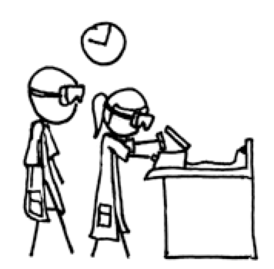
Who can Access the Data?
Visibility
Collaborators
Public
Institution
Lab
Members
Owner

Slide 26
Three Challenges
Data
Demand
People

Slide 27
Challenge #2
The Demand
More Researchers
More Experiments
More Samples per Lane
Push for Faster Results
Slower
Response
Times
Notes:
Appetite

Slide 28
It is a shame
To ANNOY the user
…….in the first 20 seconds

Slide 29
Addressing the Bottlenecks
App Server
Data Transfers
File Conversions
Faster Authentication
Apache Tomcat
Efficient Database Queries
Offload to Batch Processing
Thinner Client
More Hardware
Workload Balancing

Slide 30


How many servers are we talking about?
GNomEx | Image Processing | Analysis
Fast
Disk
Analysis
Fast
Disk
Tomcat
FDT
Database
Server
Fast
Disk
Data
Pipeline
Fast
Disk
High
Performance
Clusters
File Server
Slow Disk
The Repository
Notes:
Hci-bio-app
24 cores, 64GB memory
550GB Fast Disk
Analysis Servers:
3 servers, 12 Cores,
64GB RAM
Clusters:
High Performance
X 24 Cores,
24-64GB RAM
Analysis: 3 Servers,
12 CPU cores,
64 Gb RAM each,
14 Tb fast disk
HCI-Bio-FS
16x Logical CPU's (2x Xeon E5620)
16GB Memory
100 TB SATA
Hci-bio-app
HP ProLiant DL380p Gen8 Server 653200-B21
Intel Xeon E5-2620 (2.0GHz/6-core/95W) 662250-L21
HP 32GB (2x16GB) Dual Rank x4 PC3L-10600 (DDR3-1333) Reg CAS-9 LP Memory Kit 647901-32G Intel Xeon E5-2620 (2.0GHz/6-core/95W) 662250-B21
HP 32GB (2x16GB) Dual Rank x4 PC3L-10600 (DDR3-1333) Reg CAS-9 LP Memory Kit 647901-32G HP Integrated Lights-Out
HP Integrated Lights Out 4 (iLO 4) Management Engine
Storage controller
HP Smart Array P420i/Zero Memory Controller
HP 300GB 6G SAS 15K rpm SFF (2.5-inch) SC Enterprise 3yr Warranty Hard Drive 652611-B21
HP 300GB 6G SAS 15K rpm SFF (2.5-inch) SC Enterprise 3yr Warranty Hard Drive 652611-B21
HP 300GB 6G SAS 15K rpm SFF (2.5-inch) SC Enterprise 3yr Warranty Hard Drive 652611-B21
HP 300GB 6G SAS 15K rpm SFF (2.5-inch) SC Enterprise 3yr Warranty Hard Drive 652611-B21 RAID 5 drive set with online spare (requires matching 4 hard drives) 339780-B21
HP Slim 12.7mm SATA DVD Optical Drive 652232-B21
HP Ethernet 1GbE 4-port 331FLR Adapter 684208-B21
2 HP 460W Common Slot Gold Hot Plug Power Supplies 503296-2PS
2 HP C13 - AS3112-3 AU 250V 10Amp 2.5m Power Cord AF556A-XX2
HP 2U SFF Gen8 Rail Kit 663478-B21
HCI-Moab
4x Logical CPU's (1x Xeon E5506)
16GB Memory
HCI-Alta
24x Logical CPU's (2x Xeon X5650)
64GB Memory
HCI-Moab
24x Logical CPU's (2x Xeon X5650)
64GB Memory
10TB SAS

Slide 31
Biggest Bottleneck is….
Getting the features implemented and bugs fixed in GNomEx.
Notes:
Critical to staff a software develop project at the right levels. Developing enterprise software and housing big data is not cheap.
REDO – Show backlog

Slide 32
Three Challenges
Data
Demand
People

Slide 33

Different Users, Different Perspectives
3 Core Facilities
Bioinformatics
Researchers at your Institution
Outside Researchers
Accounting

Slide 34
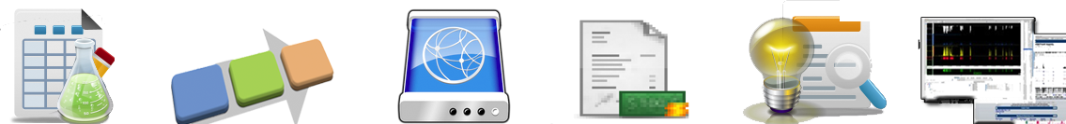
Three Kinds of Users
Submit
Experiment
Workflow
Results
Delivery
Automated
Billing
Analysis
Visualization
Researcher
Submit
Annotate
Preapprove
Track
Download
Pay
Download
Core
Authorize
Register
Record
Review
Split
Invoice
Browse
Bioinformatics
Data Pipeline
Analysis Pipeline
Upload
Annotate
Organize
Link
Organize
Browse

Slide 35
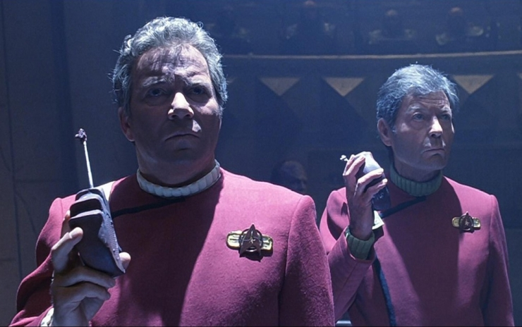
We Don’t Always
Speak the Same Language
Core Facility
Software Developers
System Admin
Bioinformatics
Molarity
Adapters
Cluster density
Spike in
Optical Error
5’ vs 3’
Image
Copy
NICs
NFS
Case/Control
REFS
Linux
Kernal
CpG Islands
P-Value
FDR
Cluster Nodes
Interface
Eclipse
JDK
Hibernate
Inheritance
SQL
Ant
Notes:
Core Facility – Molecular biology, Constant pressure from researchers, Dealing with instrument failures, Worried about making a expensive mistake
Software Developer – Lives in source code, Tries to make abstract model from domain, Understands little if any molecular biology
Sys Admin – The keeper of the data, knows how things work at a hardware level, speaks a different geek dialect than software developer, equally baffled by molecular biology terms
Bioinformatics – Understands both the molecular biology and computational domain. Deals with huge files, huge jobs, baffling data.
Need diverse knowledge base and skill set to build this kind of software
Shared Understanding, Figuring out how to talk to each other
Respect
Curiosity
Trust
Keep it real
.

Slide 36
But We Share the Same Goal
Deliver clean, beautiful data to the Researcher as quickly as possible…..

Slide 37
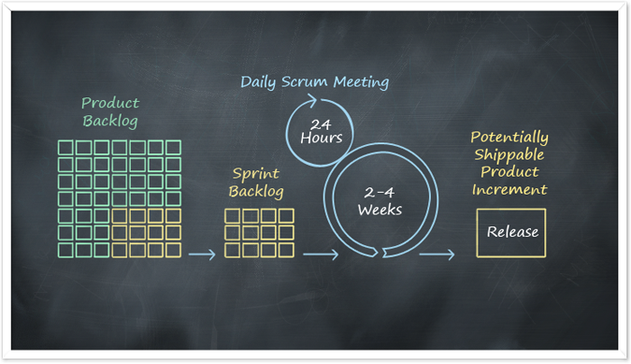
Agile Development
Reducing Risk by shortening the Delivery Window
Notes:
Developers depend on concrete user experiences to get it right
Release Often, but Release Flawlessly
Everyone contributes to each Sprint
Daily Standups
Complete Transparency
Scrum board

Slide 38
Agile Manifesto
Value… | More Than…
Individuals and Interactions | Processes and Tools
Working software | Comprehensive Documentation
Customer Collaboration | Contract Negotiation
Responding to Change | Following a Plan

Slide 39
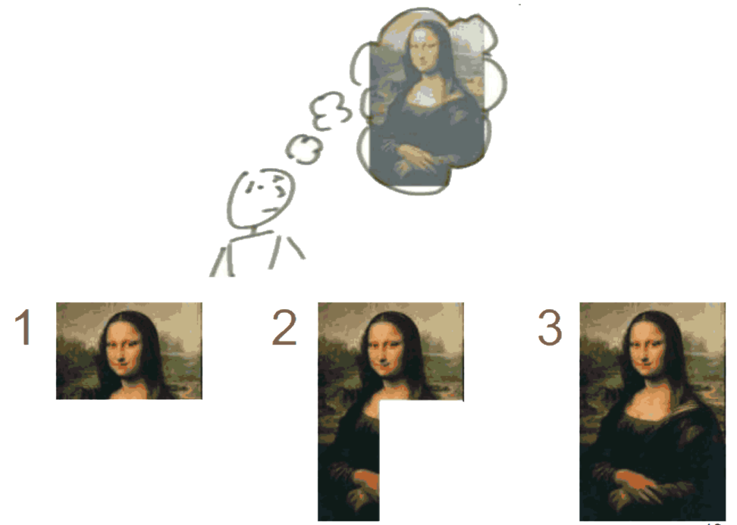
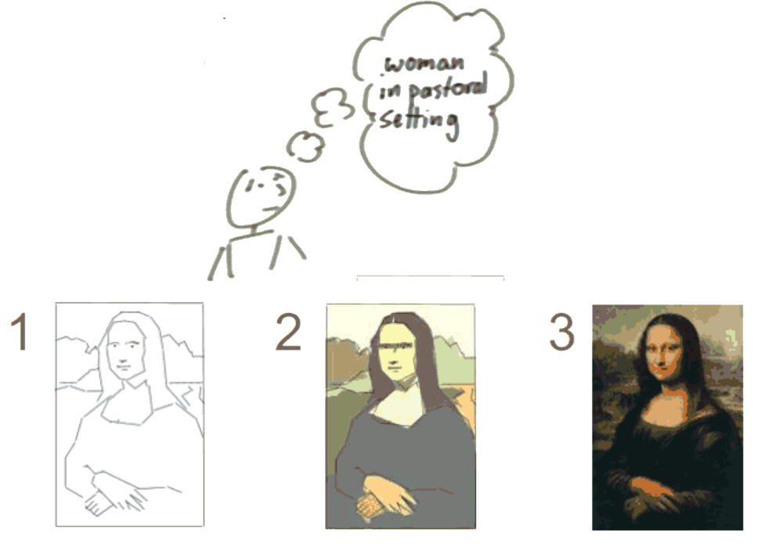
Iteration
Incrementing
Iterating
Notes:
Two ways to deliver, pick the best one for your team and the problem

Slide 40
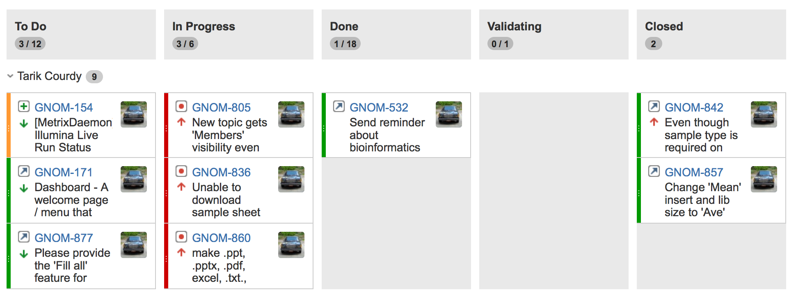
Our Scrum Board

Slide 41
In Summary
Data
Demand
People
Housing Big Data requires
$ and expertise
System performance
Is multi-faceted
Work towards Shared Understanding.
Build a team and process that embraces change.

Slide 42
Plans
Reporting
Mobile app for Work lists
Usability, Simplify Interface
Translational Research
Abstracting and Mining Genomic Findings

Slide 43
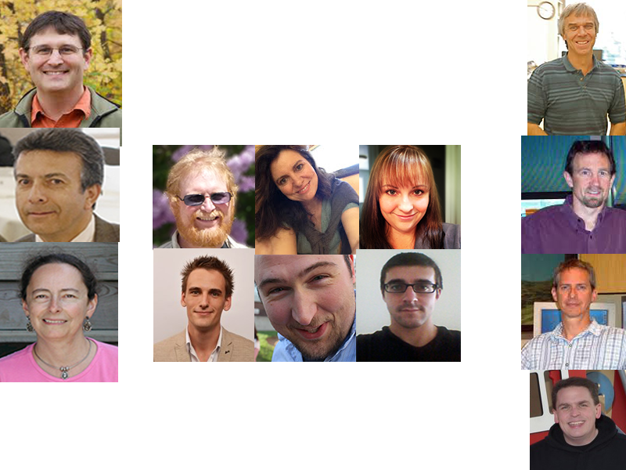
Special Thanks

Slide 44
Parting Thoughts
Privileged to work in this field
  Working with bright, interesting, fun, and nice people
  In an area exploding with new advancements
  That will ultimately lead to important scientific discoveries
http://www.sourceforge.net/projects/gnomex
http://hci-scrum.hci.utah.edu/gnomexdoc
tony.disera@hci.utah.edu

